Slide 1
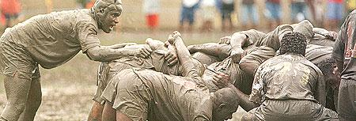
Agile Project management
22-23-24 April-2017. Boughdiri Aymen

Slide 2
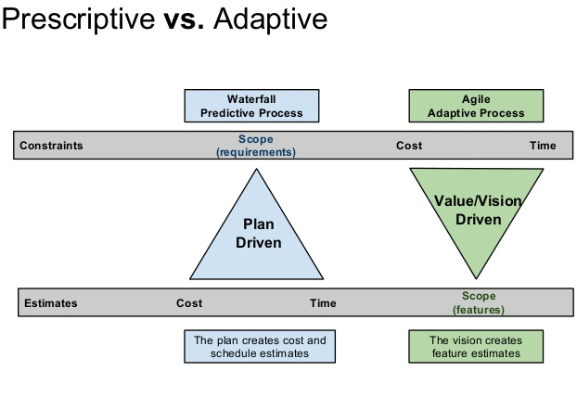

Slide 3
Predictive approach
Release
Design spec
Requirements spec
Order
C
D
Actual
need
P
P
R
Notes:
3
Stefan
Predictive approach. Specifications upfront.
The Customer have some idea of something he or she wants.
The Requirement specialist tried to nail down these ideas into a requirements specification document. He/she has to aim quite far and missed the target little bit.
The Design specialist then takes the requirements specification and produces a design specification. He/she has to aim quite far. It will be little bit off again.
The development team (Programmers) will take the design specification and produce a product release. Again the have to make a long shot to get to the requirements and miss the target somewhat.
During the time when the requirement specialist, the design specialist and the development team has been working not the release, the customer change his mind little bit. And after the release we can see that the software did not meet the actual needs that the customer had.
C = Customer
R = Requirement specialist
D = Design specialist
P = Programmer

Slide 4
Adaptive approach
Vision
C
Actual need
Notes:
4
Stefan
Adaptive approad. Defer decisions
The customer has a vision. Now there is a team with requirements specialist, designers and programmers. The TEAM takes a part of that vision to be working on during the first iteraction. Aiming is easier now with a shorter distance.
They release a part of the vision, which the customer can have a look at and give feedback on.
The customer can now adjust his vision and give the team another piece of it
The team has learnt some from the first iteration and the next shot is also shorter than in the previous example.

Slide 5
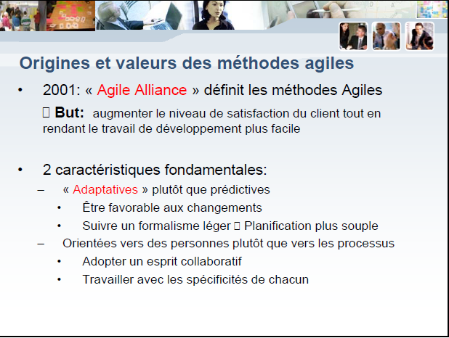

Slide 6
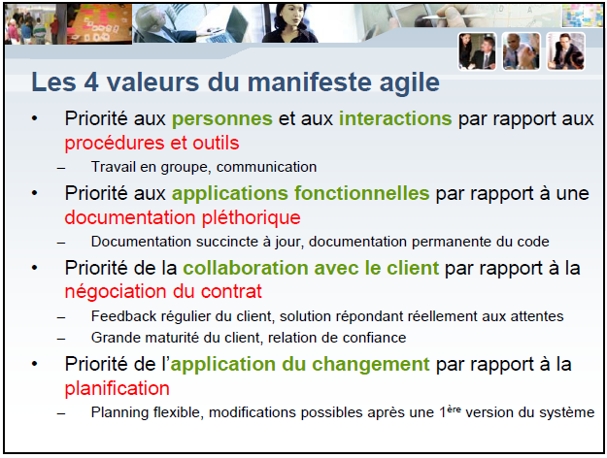

Slide 7
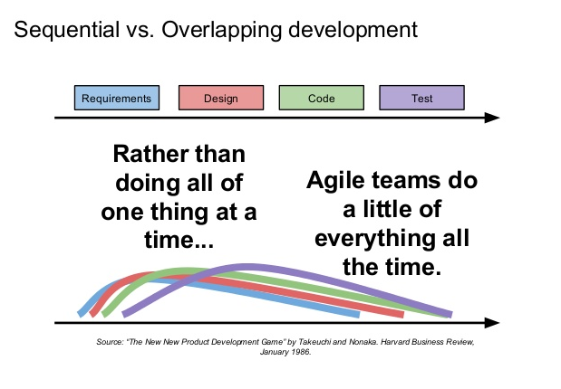

Slide 8
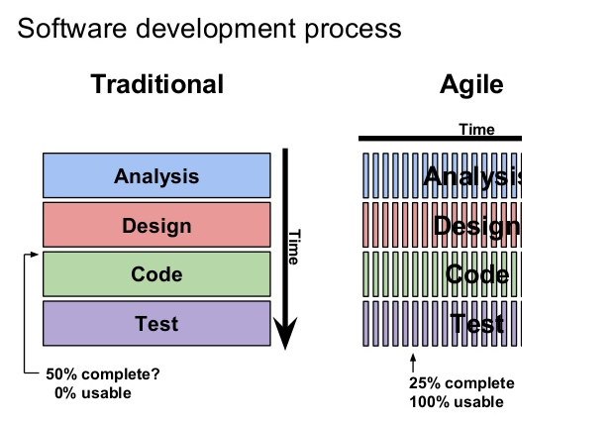
Notes:
Dans le même contexte, en 1979, USA Government
Accounting Office avait enquêté sur un certain nombre Office avait enquêté sur un certain nombre
de projets
• [47%] délivré, jamais utilisé
• [29%] payé, non fourni
• [19%] utilisé puis modifié ou abandonné
• [3%] utilisé après quelques retouches
• [2%] utilisé tel quel

Slide 9
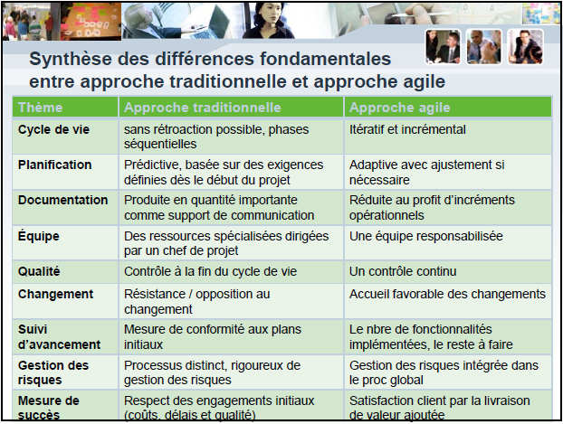

Slide 10

Agile Umbrella
More Prescriptive
more rules to follow
RUP (120+)
RUP has over 30 roles, over 20 activities, and over 70 artifacts
Agile
XP (13)
Scrum (9)
Scrum
XP
DSDM
Kanban (3)
Crystal
FDD
Kanban
RUP
Do Whatever!! (0)
and few more…
More Adaptive
fewer rules to follow
Notes:
Prescriptive means “more rules to
follow” and adaptive means “fewer rules to follow”.

Slide 11
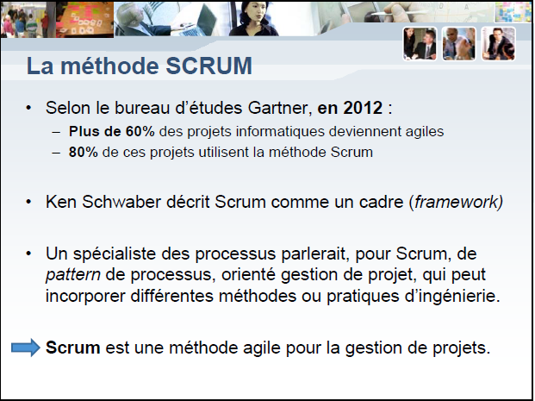

Slide 12
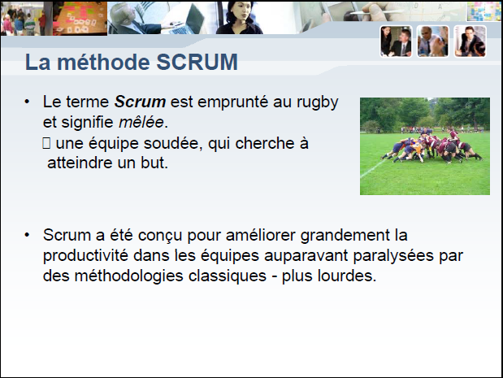

Slide 13
